Slide 1

INSTAGRAM
USER ANALYTICS
JAYESH KHARATE
02/12/24

Slide 2
Introduction
Meta Platforms Inc., also known as Meta, is a multinational technology company that builds products and services to help people connect, find communities, and grow businesses. Meta's products include:
Facebook,Instagram,WhatsApp ,etc.
Instagram is a photo and video sharing social networking service owned by Meta Platforms. It allows users to upload media that can be edited with filters, be organized by hashtags, and be associated with a location via geographical tagging. Posts can be shared publicly or with pre-approved followers. Users can browse other users' content by tags and locations, view trending content, like photos, and follow other users to add their content to a personal feed.

Slide 3
Problem Statement
As a data analyst at Meta the Marketing teams wants to leverage Instagram's user data to develop targeted marketing strategies that will increase user engagement, retention, and acquisition.
Provide insights and recommendations to address the following objectives
Distribution of user activity levels across the user base
Average engagement rate per post for each user.
Identify the top users with the highest engagement rates.
Total engagement over a month.
Identify popular hashtags.
Identify users who have never liked any posts.

Slide 4
Data Overview
Data Description:
comments_id : unique identifier for each comment
comment_text : text content of a given comment
user_id : unique identifier for each user
photo_id : unique identifier for each photo
created_at : date of interaction in the form like, photos, tags
follower_id : user_id of the follower for a certain user
followee_id : user_id of followee for a certain user
tag_id : unique identifier for each tag
image_url : link to the image posted on the platform
username : username chosen by the user

Slide 5
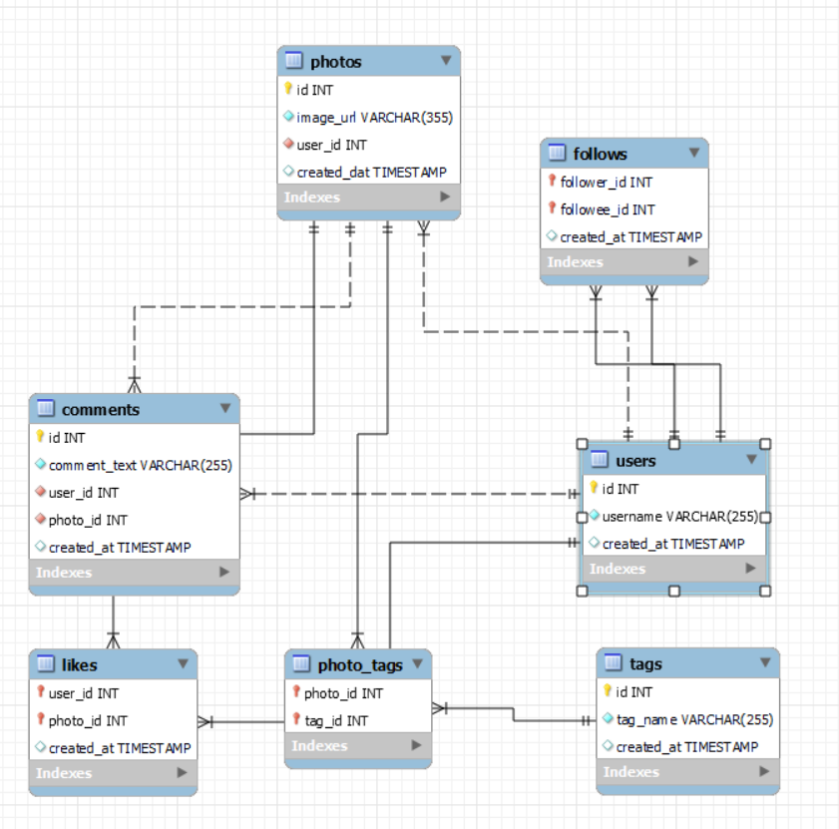
Data Overview
Database Schema:

Slide 6
User Activity Levels - Posts
The chart shows the data of total number of posts for users.
The x-axis shows the total posts and y-axis shows count of users.
Most of the users have less than 10 posts.
Only one user with username Eveline95 has most number of posts.
The difference between each users is >=0 and <15
These metrics are important because it is used to calculate the user engagement rate.
number of posts per users

Slide 7
User Activity Levels - Comments
The chart shows the total number of comments for users.
The x-axis shows the total comments and the y-axis count of users.
While some of the users have made more than 250
comments, most of the users have made less than 100
comments.
13 users have made 257 comments which is the highest Number of comments made by an user.
Since there are total 100 users it makes it 13% of users have made highest comments.

Slide 8
User Activity Levels - Likes
The chart shows the number of likes for each user.
The x-axis shows the total likes and y-axis shows the
count of users.
While some of them have more than 250 likes, majority
of them have less than 100 likes.
13 users have 257 likes which is the highest number of
Likes among all of the users.
So 13% of users have highest number of likes.

Slide 9
Average Engagement Rate
The chart shows data of average engagement rate per post of each user.
This is calculated by adding the total number of comments and likes for each post and dividing it by the total number of posts for each user.
User with username Meggie_Doyle and user_id 55 has the highest Engagement rate at 75.
Most of the users have engagement rate less than 70.

Slide 10
Top Users
The above chart shows overall top users with highest engagement rate.
The chart shows top 10 users among total 100 users.
This is calculated by adding the total number of comments and likes for each post and dividing it by the total number of posts for each user.
From the above chart we can say that username Meggie_Doyle has the highest engagement rate(75) .

Slide 11
Top Users (a month)
id | username | Total_engagement | Rank
23 | Eveline95 | 418 | 1
59 | Cesar93 | 394 | 2
88 | Clint27 | 384 | 3
86 | Delfina_VonRueden68 | 360 | 4
58 | Aurelie71 | 332 | 5
The above chart shows the data of top users with highest engagement rate over a period i.e, Month.
The engagement above is calculated by adding the total likes, comments and tags made on posts by each user.
Top 5 users are shown in the above data from among 100 users.
From the above data we know that username Evline95 has the highest engagement over a month.

Slide 12
Most Liked Hashtag
The above chart shows the data of the top 10 most liked hashtags.
This is calculated by counting the total number likes each post got and its associated hashtags.
From the above data we know that #dreamy is the most liked.
By analysing the trends among the users it will be easy for the marketing team to target users with their interested content.

Slide 13
Inactive Users
The above table shows list of users(few) who have never liked or commented on any post.
These users have zero or more posts but zero likes and zero comments.
So from this data we can analyse that 23% of the users are inactive.
This will help the marketing team to develop strategies like personalised ads or notifications about events they would have missed to keep them engaged.
id | username
1 | Kenton_Kirlin
7 | Kasandra_Homenick
49 | Morgan.Kassulke
25 | Tierra.Trantow
29 | Jaime53
34 | Pearl7
45 | David.Osinski47

Slide 14
Usage of user-generated content
By Identifying Popular Tags, Interests and Segmenting Users Based on Interests, Analyzing Influencers engagement to Personalize Ad Content Based on User Engagement and Measure Campaign Effectiveness.
For example, user with username Janet.Armstrong is one of the top influencers and the tags used by the user is ‘beauty’ when we analyse the user segment of tagnames. Hence, we can focus on tailoring the ad campaigns in beauty and similar concepts to reach the targeted audiences.

Slide 15
Strategies for high user engagement
User Engagement:
1.Content personalization:
- Use Instagram Insights to analyze user demographics, interests, and interactions.
- Create content tailored to specific user groups (e.g., age, location, interests).
2. Hashtag targeting:
- Research popular hashtags.
- Identify relevant hashtags for your brand and target audience.
- Incorporate hashtags into your content and ads.
3. Influencer partnerships:
- Identify influencers with engaged audiences aligning with your target demographics.
- Collaborate with influencers to create sponsored content.
- Monitor influencer performance using Instagram Insights.

Slide 16
Strategies for high user engagement
User Retention:
1. Re-engagement campaigns:
- Identify inactive users using Instagram Insights.
- Create personalized content and offers to re-activate them.
-Utilize Instagram's features like Stories and Reels to re-engage users.
2. User journey mapping:
- Analyze user behavior using Instagram Insights.
- Identify drop-off points in the user journey.
- Optimize the Instagram experience by improving content, navigation, or CTAs.
3. Loyalty programs:
- Develop programs rewarding consistent engagement and interactions.
- Utilize Instagram's features like badges and rewards.
- Collaborate with influencers to promote loyalty programs.

Slide 17
Strategies for high user engagement
Additional Strategies:
A/B testing:
- Continuously test and optimize marketing strategies using Instagram Insights.
- Compare performance of different content, hashtags, and targeting options.
2. Sentiment analysis:
- Monitor user sentiment using Instagram Insights.
- Identify areas for improvement and adjust marketing strategies.
3. Competitor analysis:
- Analyse competitors' Instagram strategies using Instagram Insights.
- Identify gaps and opportunities to improve your marketing strategy.

Slide 18
Conclusion
As an analyst at Meta, utilizing Instagram user analytics is key to enhancing user retention, acquisition, and engagement. By analyzing user data, you gain insights into content preferences and behavior, allowing for tailored strategies that resonate with different audience segments. This includes developing personalized content.
Effective implementation of targeted marketing campaigns, coupled with A/B testing, helps identify and refine successful strategies. Monitoring performance metrics and incorporating user feedback ensures continuous improvement. Sharing these insights and scaling successful approaches further drives user engagement and supports growth objectives.
In essence, a data-driven approach enables the marketing team to create compelling user experiences, fostering stronger connections and achieving strategic goals in user retention and acquisition.

Slide 19
THANK YOU

